Slide 1
Supply Chain Delay Analysis
Professional Power BI Presentation

Slide 2
Introduction
Good morning everyone.
Today I am going to present my Power BI project called “Supply Chain Delay Analysis”.
The objective of this project is to analyze delivery delays, operational risks, warehouse performance, and customer satisfaction.
Using this dashboard, the company can identify major delay reasons, reduce penalty costs, and improve supply chain efficiency.

Slide 3
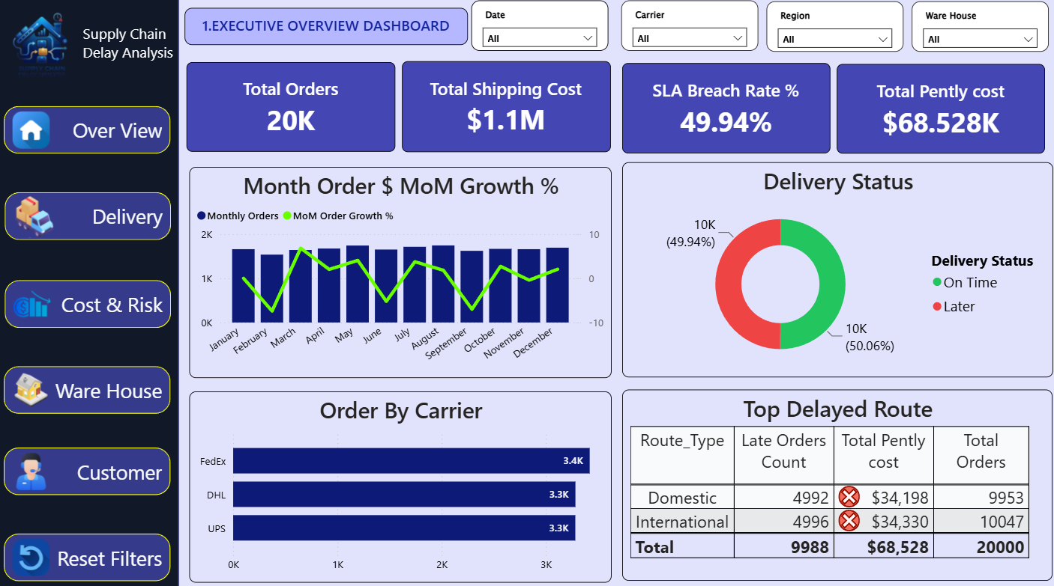
Executive Overview Dashboard
This dashboard gives a complete overview of the supply chain performance. • Total orders are 20K • Shipping cost is 1.1 million dollars • SLA breach rate is 49.94% • Total penalty cost is 68.5K dollars FedEx handled the highest number of orders. This dashboard helps management quickly understand supply chain performance.

Slide 4
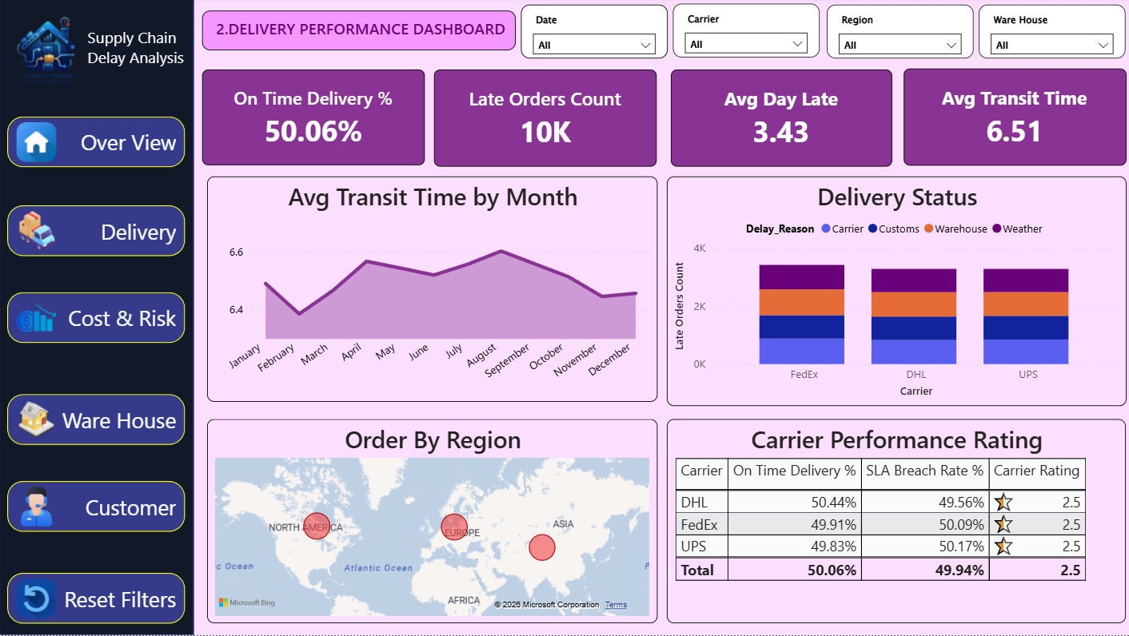
Delivery Performance Dashboard
This dashboard focuses on delivery performance. • On-time delivery percentage is 50.06% • Average delay is 3.43 days • Average transit time is 6.51 days Weather, customs, warehouse, and carrier issues caused delays. This dashboard helps identify delivery bottlenecks.

Slide 5
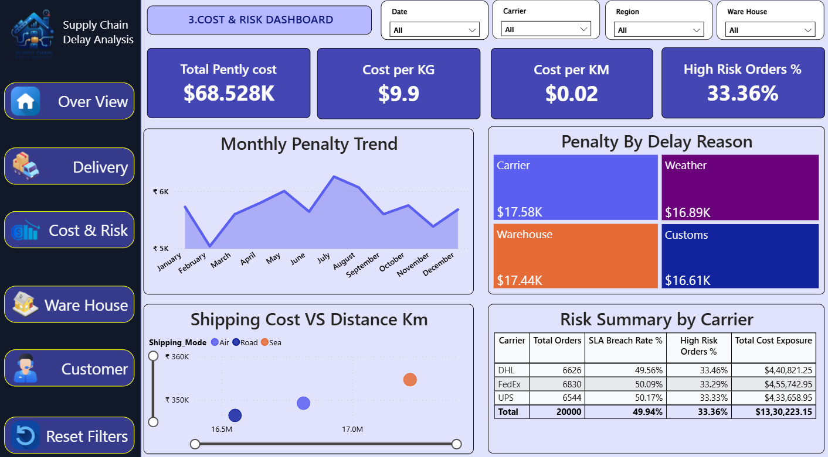
Cost and Risk Dashboard
This dashboard explains logistics cost and operational risks. • Total penalty cost is 68.5K dollars • Weather delays generated the highest penalty cost • High-risk orders are 33.36% This dashboard helps reduce financial loss and improve planning.

Slide 6
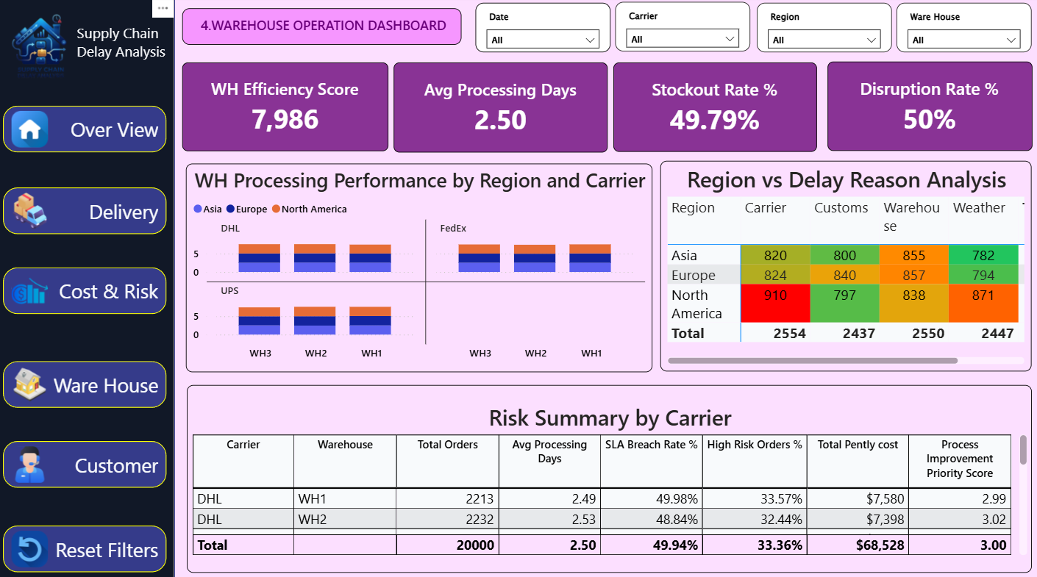
Warehouse Operation Dashboard
This dashboard analyzes warehouse efficiency. • Average processing time is 2.5 days • Stockout and disruption rates are close to 50% • North America has higher carrier delays This dashboard supports warehouse improvement decisions.

Slide 7
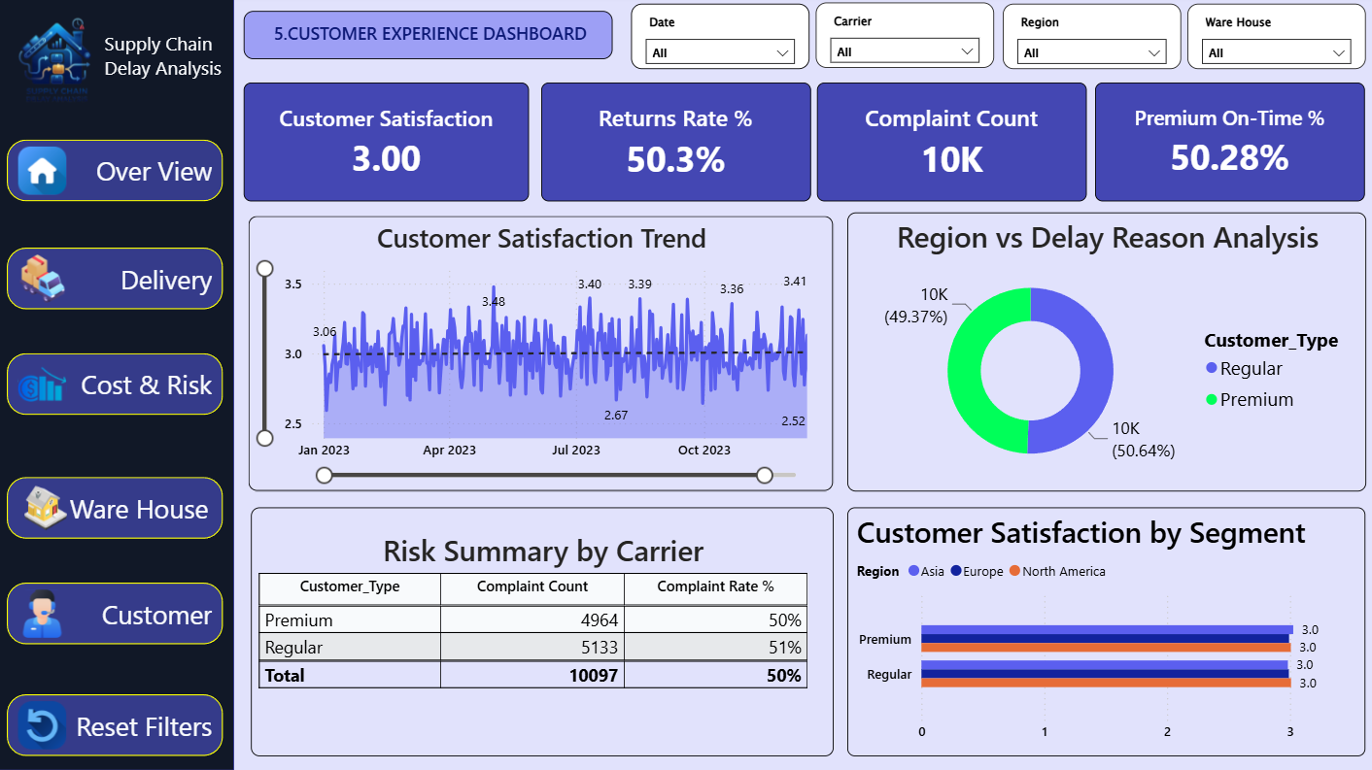
Customer Experience Dashboard
This dashboard focuses on customer satisfaction. • Satisfaction score is 3 out of 5 • Return rate is 50.3% • Complaint count is around 10K Customer satisfaction remained stable throughout the year.

Slide 8
Conclusion
To conclude, this Supply Chain Delay Analysis dashboard provides insights into delivery performance, operational risks, warehouse efficiency, and customer satisfaction.
From this analysis, we identified that weather issues, warehouse delays, and customs processing are the major reasons for delivery delays and penalty costs.
Using Power BI, the company can monitor KPIs, improve operational planning, reduce SLA breaches, and improve customer satisfaction.
Overall, this project supports better business decisions and improves supply chain efficiency.
Thank you.

Slide 9
Questions and Answers
1. Why is the SLA breach rate high?
Because of weather conditions, warehouse delays, and customs processing.
2. Which carrier handled the highest orders?
FedEx handled the highest number of orders.
3. What is the major reason for penalty cost?
Weather-related delays generated the highest penalty cost.
4. How can the company reduce delays?
By improving warehouse operations, route planning, and carrier monitoring.
5. Why did you use Power BI?
Power BI provides interactive dashboards and easy business insights.

